Slide 1
Capstone Project- Business Analyst Career Program
Submitted by-
Archit Mohan Srivastava

Slide 2
Overview
The dataset contains information about sales of a product in various countries, segmented by different product segments. It includes the number of units sold, manufacturing price, sale price, gross sales, discounts, sales, cost of goods sold (COGS), and profit for each sale. The data is further categorized based on the discount band that was applied to the sale.
In addition to the sales data, the dataset also includes information about the date of each sale, including the month number, month name, and year.
Overall, the dataset provides a detailed view of product sales performance across different countries, product segments, and discount bands. This information can be used to analyze trends and make strategic business decisions.

Slide 3
Contents
Background
Exploratory Data Analysis
Statistical Analysis
Descriptive Analysis
MySQL- Queries
Observations
Recommendations
Conclusion
Important Links

Slide 4
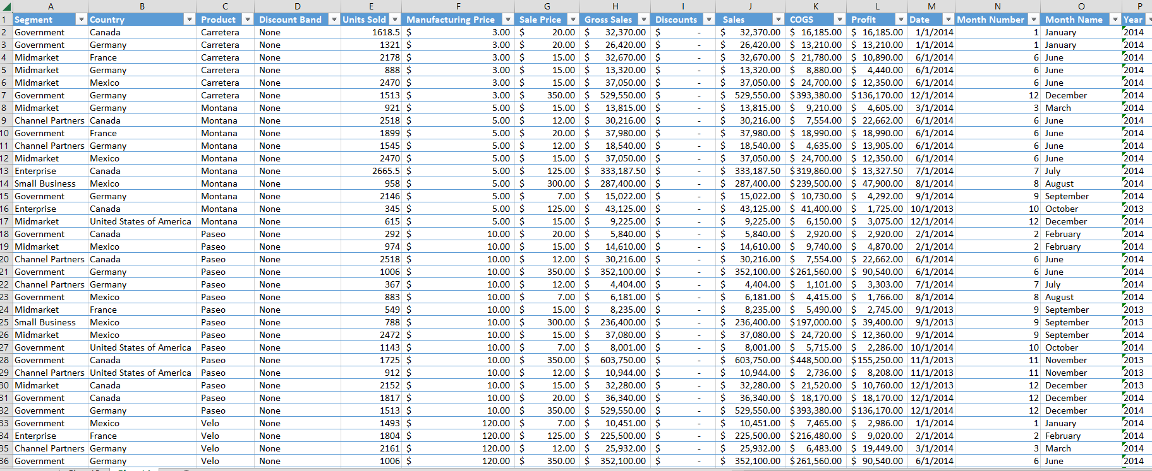
Background
The dataset includes information about sales and profit for different products in various countries. The dataset likely comes from a company that sells products to different countries and tracks their sales performance.
The dataset is useful for analyzing sales and profit trends across different products and countries. It can also be used to identify which products and countries are performing well or poorly, and to identify opportunities for improvement.
The dataset contains 700 observations of monthly sales and profit across 6 products, sold in 5 countries from 2013 to 2014.
Figure : Screenshot of the dataset

Slide 5
Exploratory Data analysis
The data contains monthly sales and profit of products across multiple segments and countries.
The data captures sales and profit from September 2013 till December 2014.
The dataset also contains discount bands for a given product basis the segment and country for a given month.
The dataset captures sales and profit of 6 products for 5 countries (U.S.A, Canada, Germany, France, Mexico) across 5 segments (Government, Channel Partners, Enterprise, Small Business, Mind Market).

Slide 6
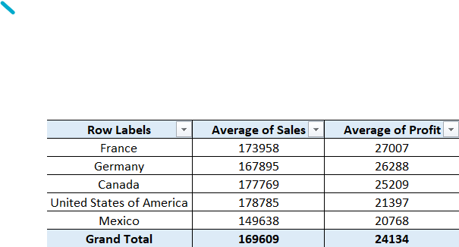
Statistical Analysis
The dataset shows that USA has the highest average sales and France has the highest average profit.
Mexico having the lowest average sales and profit both.

Slide 7
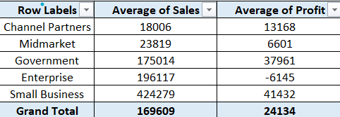
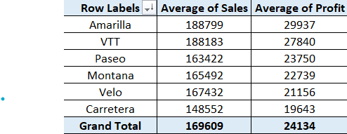
Statistical Analysis
The dataset shows that the small businesses accrue the highest average sales and highest average profits both.
While, Channel Partners is having the lowest average sales across all segments and Enterprise is having losses of USD 6145.
Under products, Amarilla is having the highest sales average and highest average profit as well.
While, Carretera is having the lowest average sales and the lowest average profits as well.

Slide 8
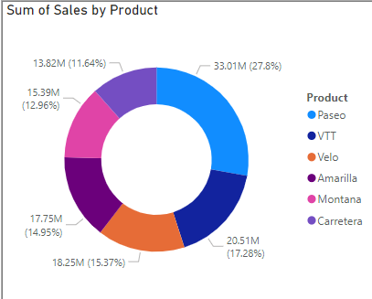
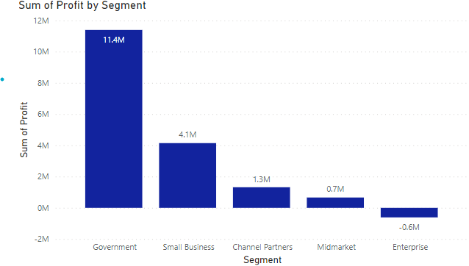
Descriptive Analysis
Product-wise sales shows that Paseo and VTT account for more than 50% of all the sales across all the products.
The dataset is showing that Government segment is having highest profits while Enterprise is incurring losses.

Slide 9
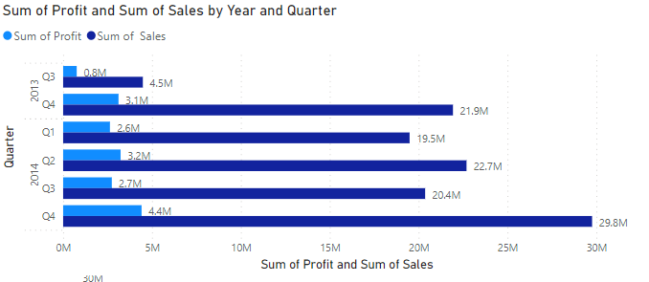
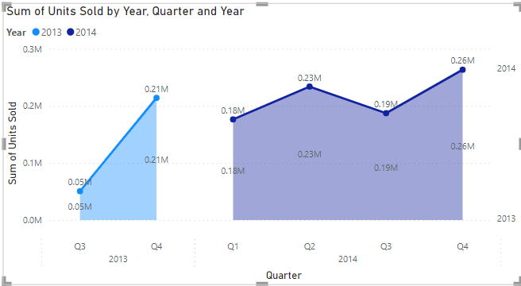
Descriptive Analysis
Profit and sales see an uptrend as we move quarter on quarter, with slight dip in 2014 Q1 and Q2
The same trend is observed in units sold per quarter, there is a general uptrend with dips in 2014 Q1 and Q2.

Slide 10
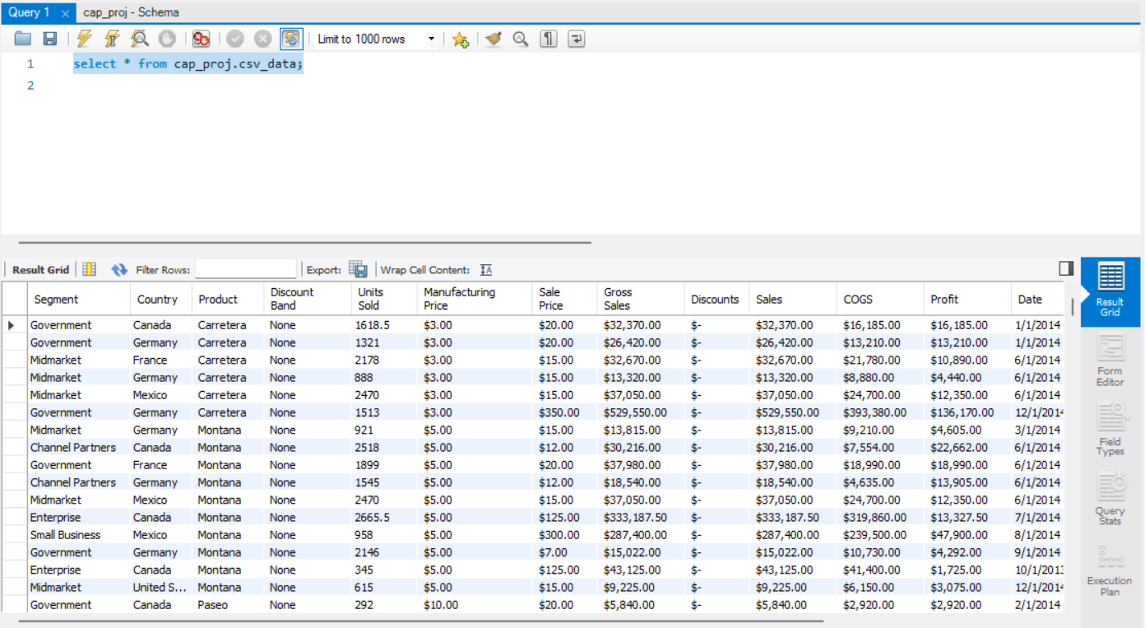
MySQL - Queries
The adjacent screenshot is showing the select all function after importing the dataset in MySQL Workbench.

Slide 11
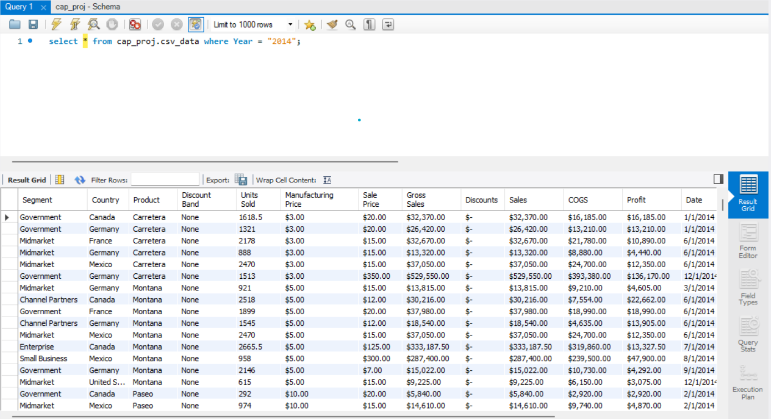
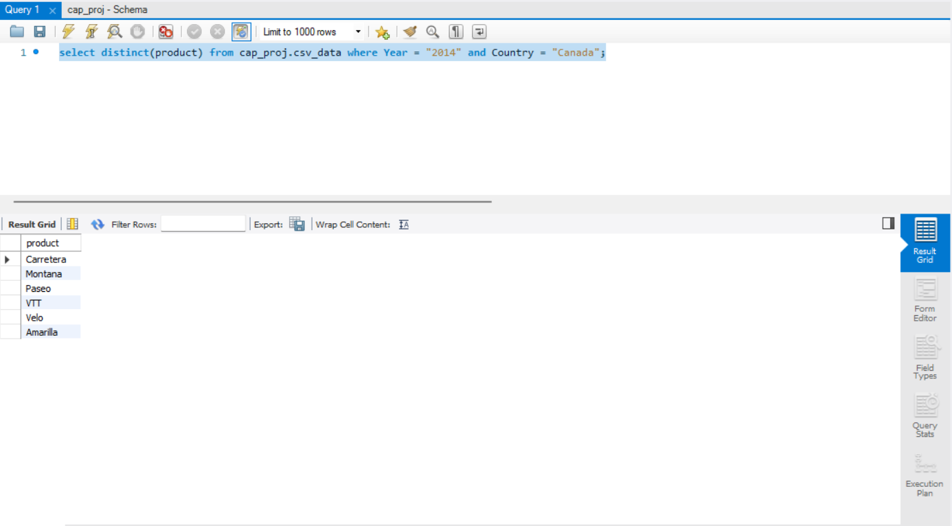
MySQL - Queries
Following two screenshots are showing all the sales transactions from the Year 2014 and Products purchased in that year in Canada.

Slide 12
Observations
The dataset contains information about sales of different products across various countries, segments, and discount bands.
The "Discount Band" column is related to the level of discount offered(High, Medium & Low in this case) on each product, and has an impact on sales and profits. Most discount being offered to Government segment.
The "Gross Sales" and "Sales" columns indicate the total amount of revenue generated from sales, while the "COGS" column represents the cost of goods sold.
The "Profit" column is calculated as the difference between the "Sales" and "COGS" columns, and is an important metric for understanding the financial performance of the company. While USA and Canada are having more sales France and Germany are enjoying higher Profit Percentage(22% each).

Slide 13
Observations
The dataset includes monthly sales data from Sept 2013 to Dec 2014, which allows for trend analysis and seasonality identification as evidently Quarter 4 for both the years show a higher sales figure.
The "Manufacturing Price" and "Sale Price" columns provide insight into the production costs and pricing strategy of each product. As shown by “Carretera” & “Montana” products, having huge difference b/w “Manufacturing Price” and “Sales Price”.
The "Segment" and "Country" columns also help us in identifying patterns and trends in sales and profits across customer groups. As Mexico is having the least sales yet accumulating almost the same profit percentage as USA.

Slide 14
Recommendations
Focus on Small Business and Government segments: These segments have the highest revenue and profit among all the segments. Therefore, these could be more prioritized and more resources could be allocate to them.
Improve profitability of Enterprise segment: The Enterprise segment is having the lowest profitability. Therefore, there should be a reduction in the cost of goods sold (COGS) which can improve the profit margin for this segment.
Expand to international markets: The dataset provided has a significant presence in the USA, Canada, France, Germany, and Mexico but there is a lot of untapped potential in other parts of the world such as India, Japan & China. There should be more focus in expanding the operations to these markets to increase the revenue and market share.

Slide 15
Conclusion
The sales and profitability analysis of the five countries (Canada, France, Germany, Mexico, and the United States of America) indicate that the highest sales were generated by the United States of America, followed by Canada, France, Germany, and Mexico.
When it comes to profitability, the highest profits were generated by the Paseo category, followed by Amarilla, VTT, Montana, Carretera, and Velo. It's worth noting that the Velo category has a relatively low profit margin compared to other categories, despite having a higher number of units sold.
The highest revenue-generating segment is Small Business, with a total sum of sales of $42,427,918.50. It is followed by Government with a total sum of sales of $52,504,260.67.

Slide 16
Conclusion
The Government segment has the highest sum of COGS, which indicates that it is the most expensive segment to operate.
The Government segment also has the highest sum of profits, indicating that it is the most profitable segment.
Canada is the second-largest market after the United States, with a total sum of sales of $13,515,935.63.
Overall, the total revenue generated is $127,931,598.50 and a total profit of $16,893,702.26.

Slide 17
Important Links
All important links are mentioned below and files attached in zin folder for detailed review.
Capstone Project Final.pbix
Western Countries Financial Data - Working file.xlsx
Capstone Project_SQL Query.sql
Capstone Project.pdf

